Slide 1
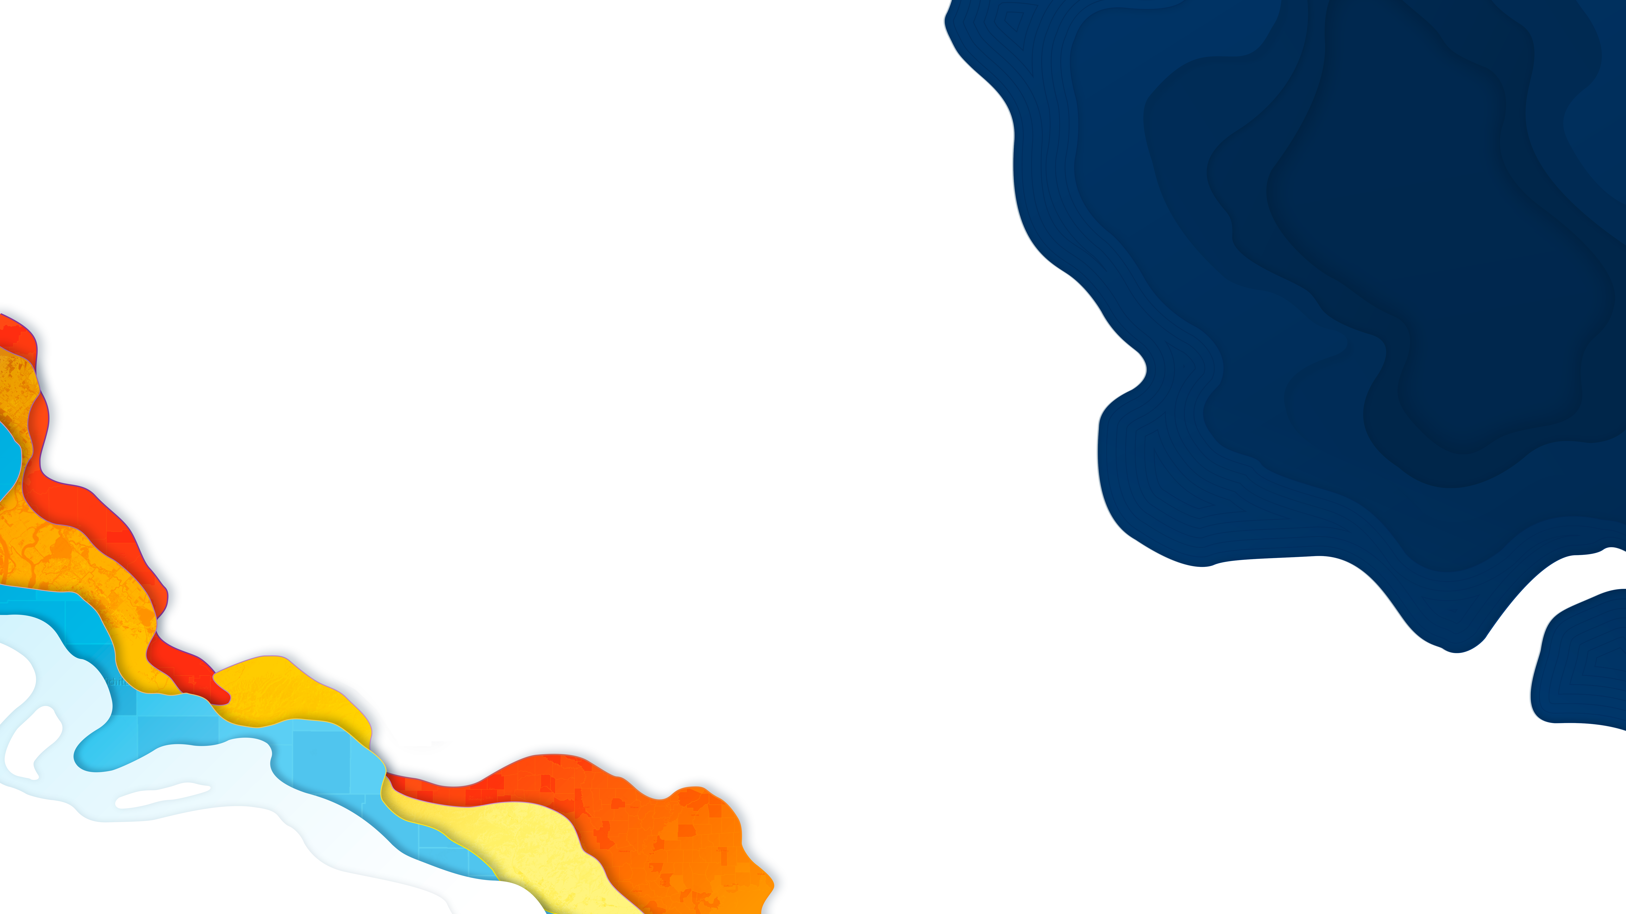

ArcGIS API for JavaScript: Data Visualization
René Rubalcava
2018 Esri Developer Summit DC

Slide 2

What will we learn?
Subhead Here
Visualizations in 2D
Visualizations in 3D

Slide 3
API Overview
Renderers, Symbols, etc.

Slide 4
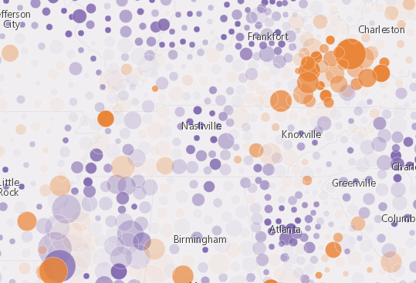
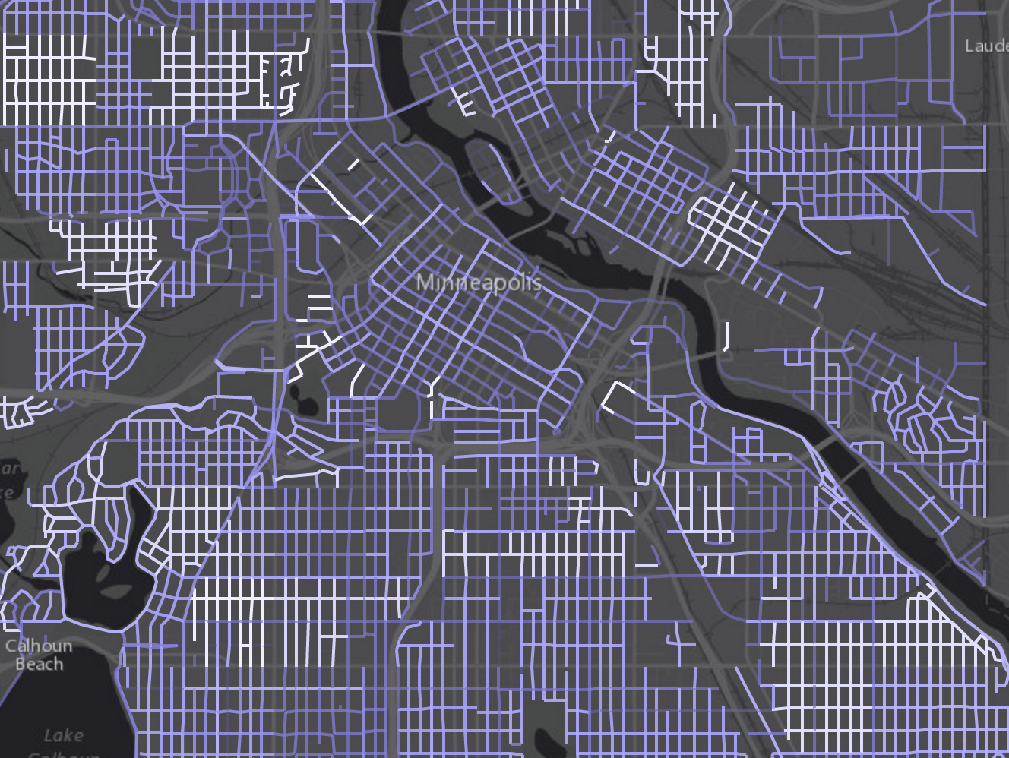
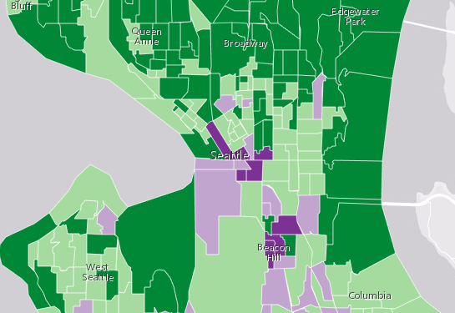
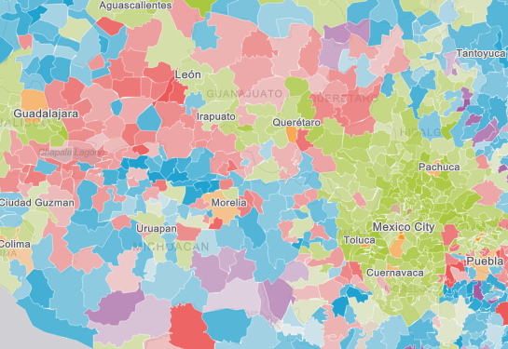
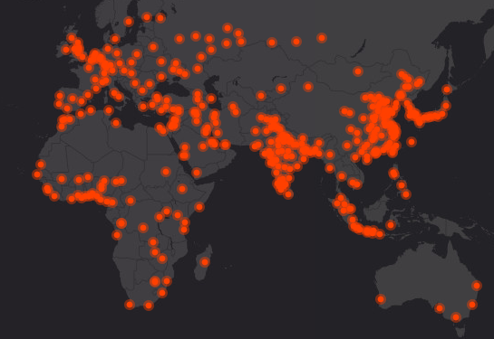
What can we visualize?
Where?
What?
How much?
When?
Multivariate

Slide 5
Data
FeatureLayer
MapImageLayer
CSVLayer
StreamLayer

Slide 6

Symbols

Slide 7
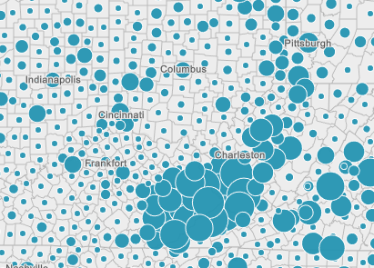
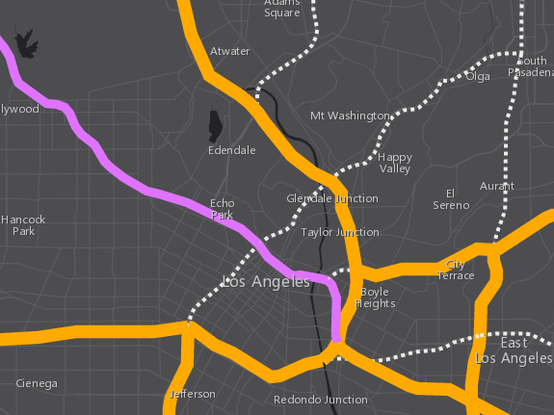
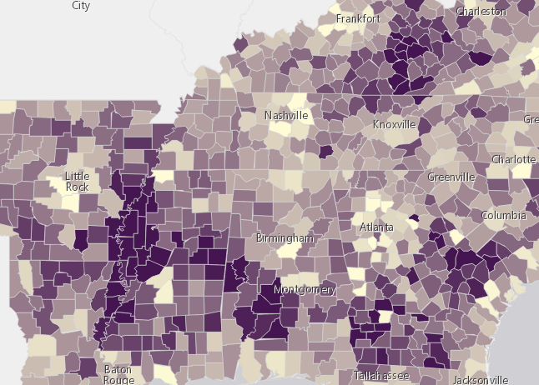
Symbols
based on geometry type
Points
Lines
Polygons
SimpleMarkerSymbol
SimpleFillSymbol
SimpleLineSymbol
PictureMarkerSymbol
PictureFillSymbol

Slide 8
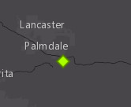
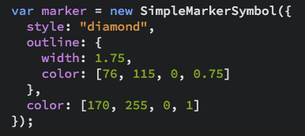
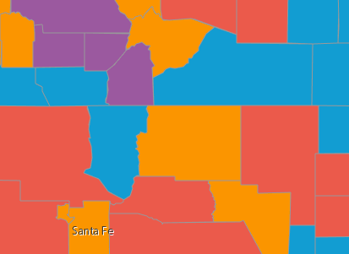

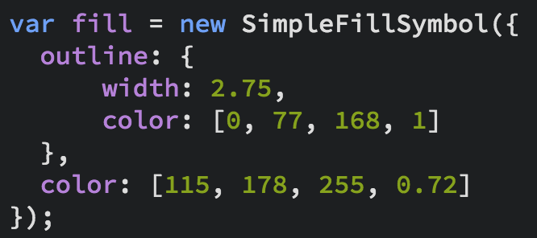
Symbols

Slide 9
Data-driven visualization
Field value(s)
TOTAL_POP
Arcade expression
Round( ($feature.BACHELOR + $feature.MASTER) / $feature.POP_25UP) );
JavaScript function
function (graphic){
return graphic.attributes.POP_DENSITY;
}

Slide 10
Renderers

Slide 11
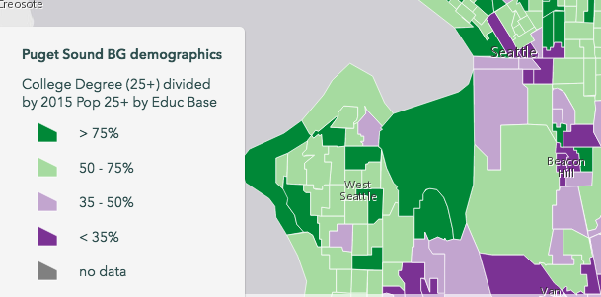
UniqueValueRenderer
Renderers
SimpleRenderer
ClassBreaksRenderer

Slide 12
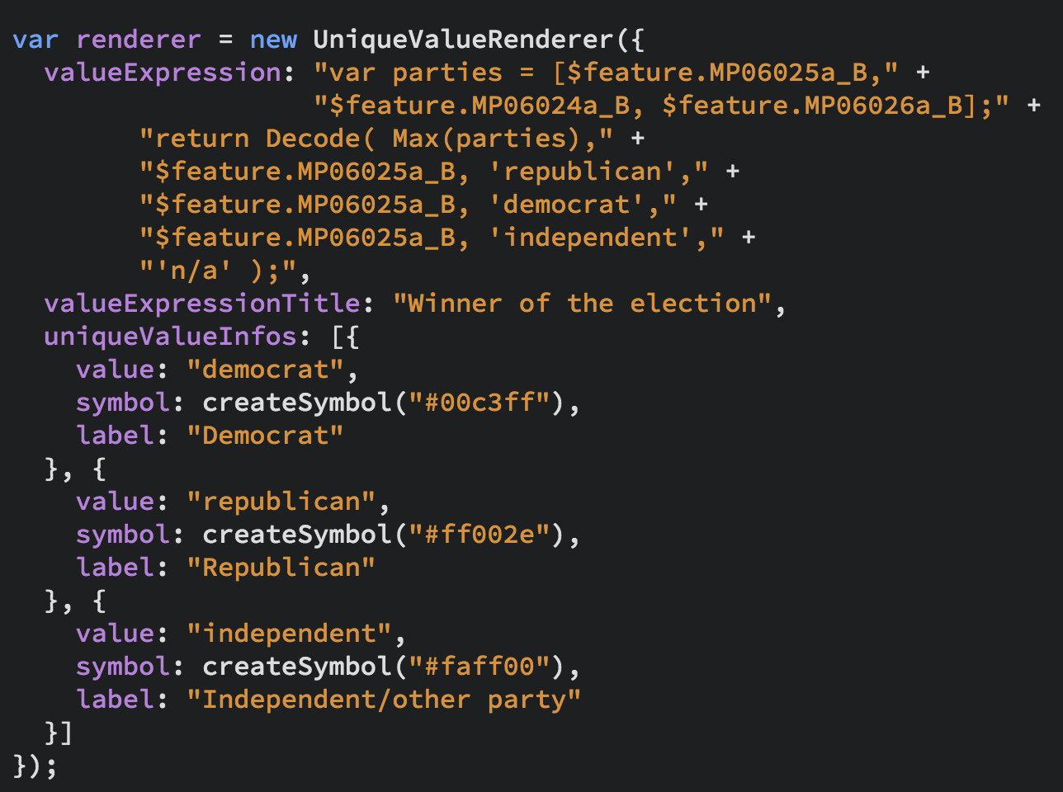
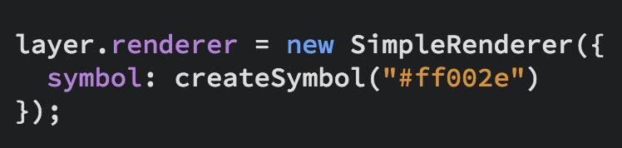
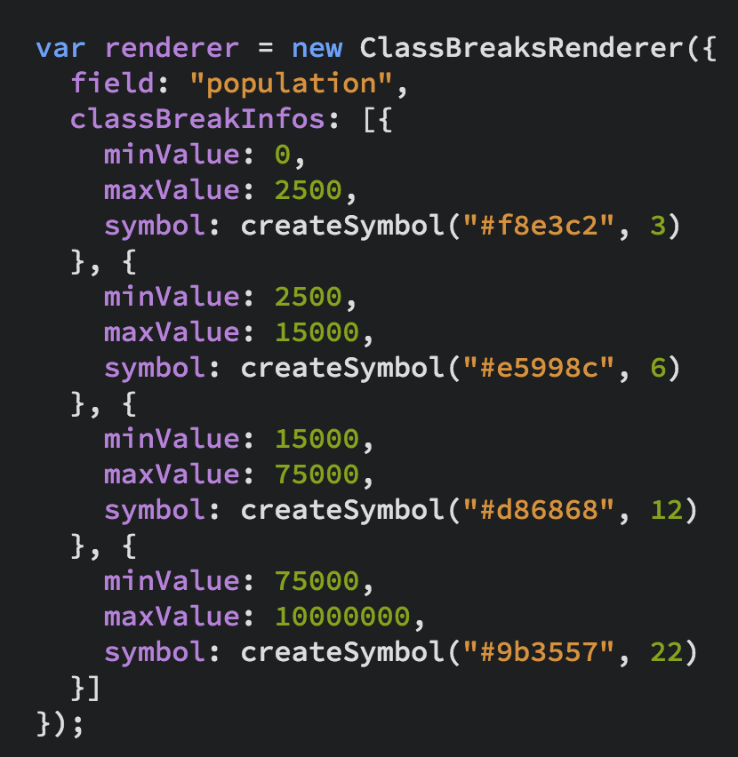
UniqueValueRenderer
Renderers
SimpleRenderer
ClassBreaksRenderer

Slide 13
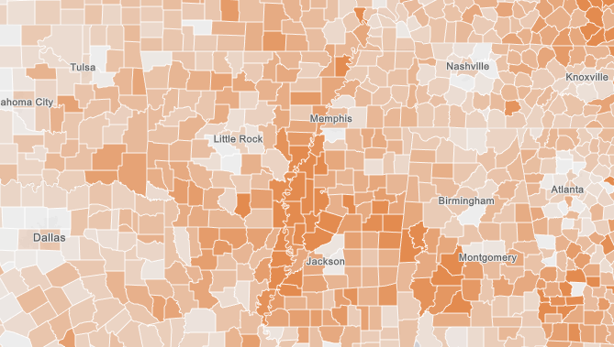
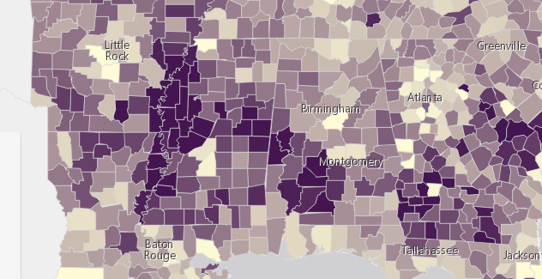
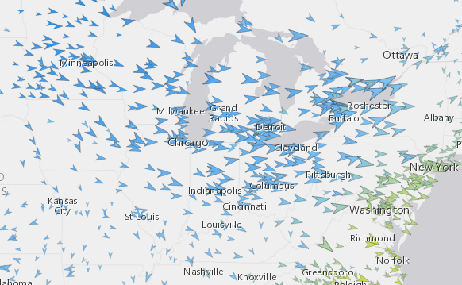
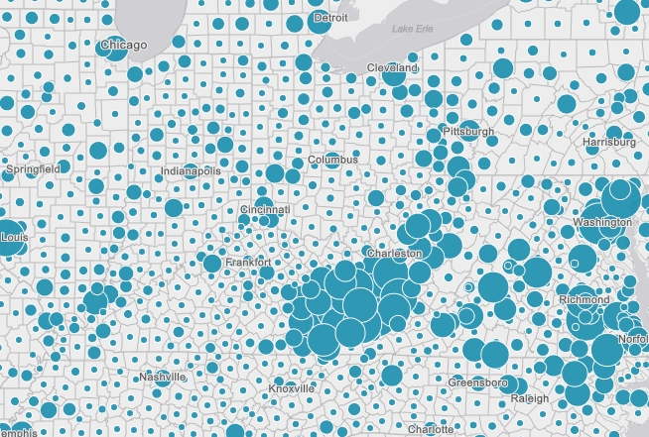
Renderers
Visual Variables
A property of the renderer
For numeric data-driven continuous visualizations
Color
Size
Opacity
Rotation

Slide 14
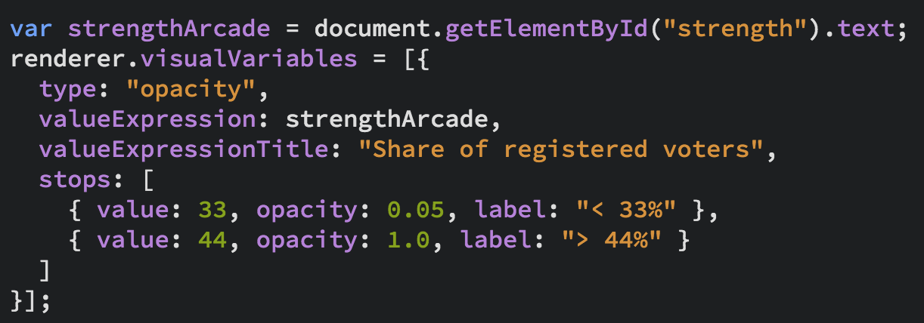
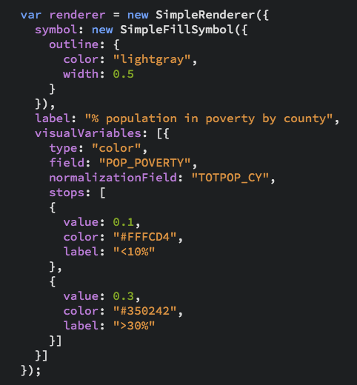
Renderers
Visual Variables

Slide 15
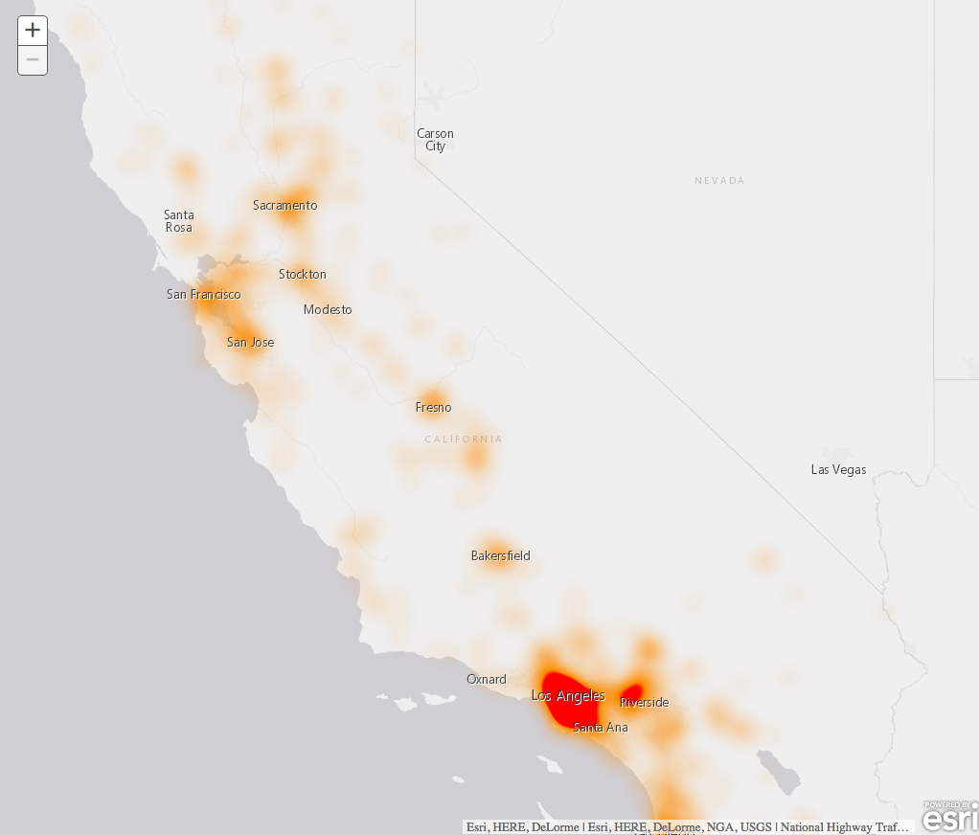
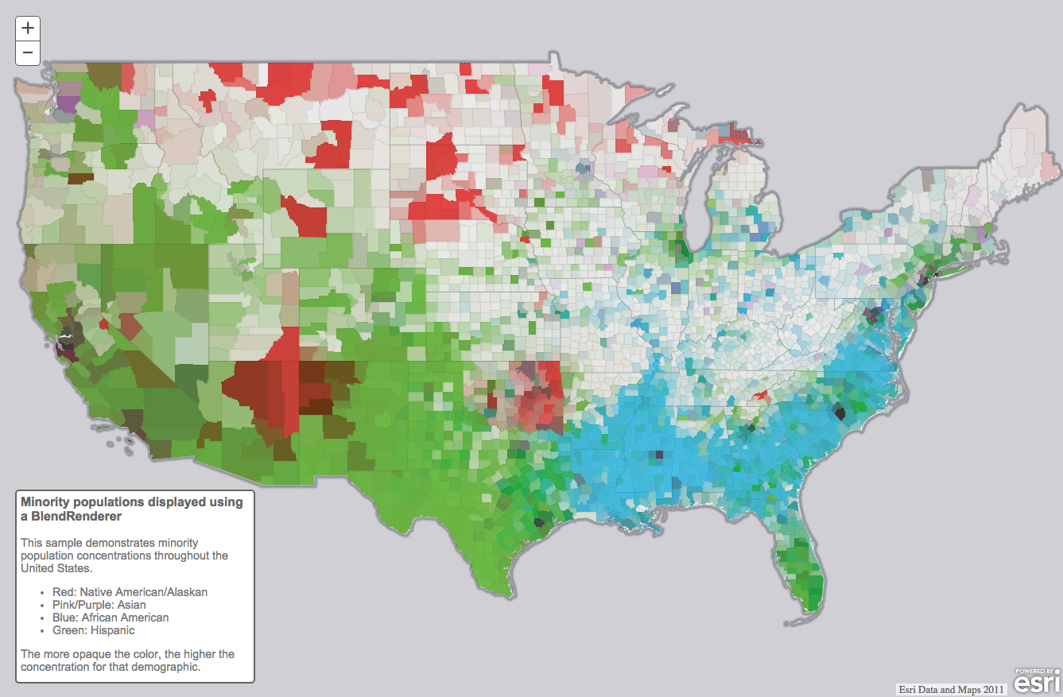
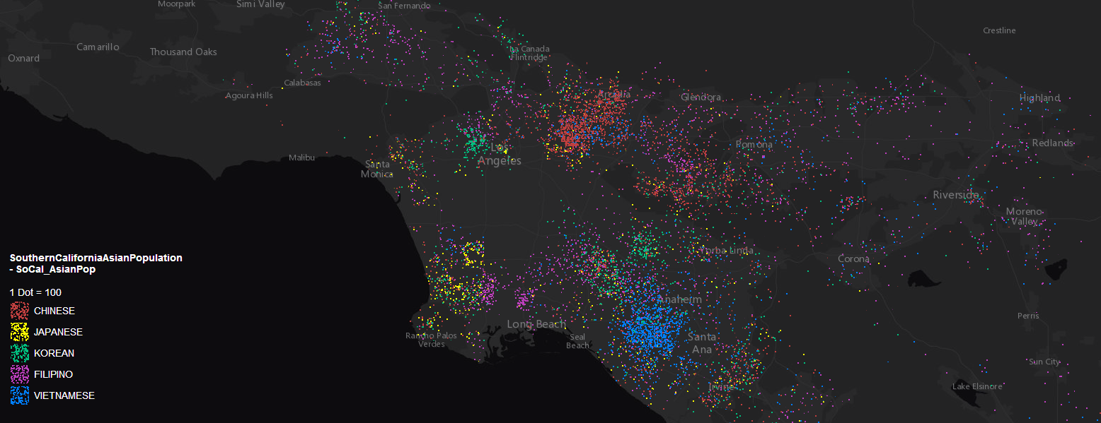
Renderers (3.x only)
HeatmapRenderer
BlendRenderer
DotDensityRenderer

Slide 16
Examples

Slide 17
3D Visualizations

Slide 18
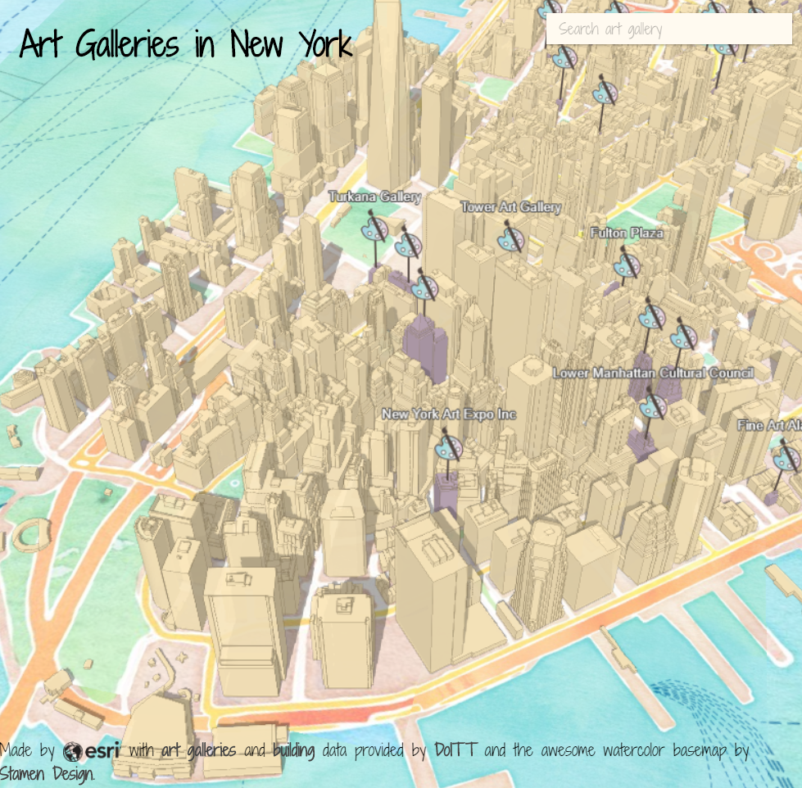
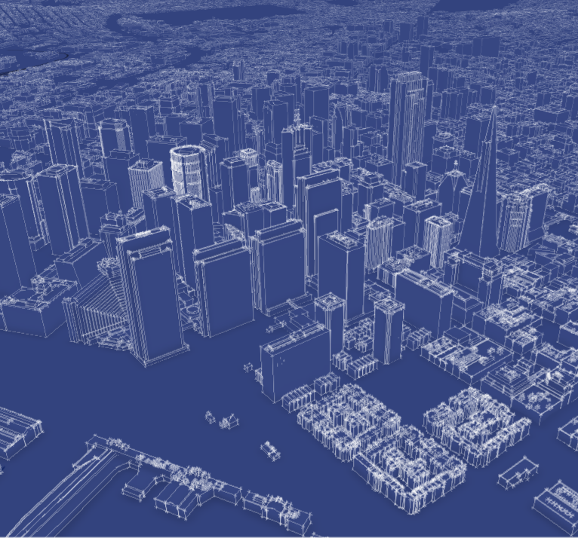
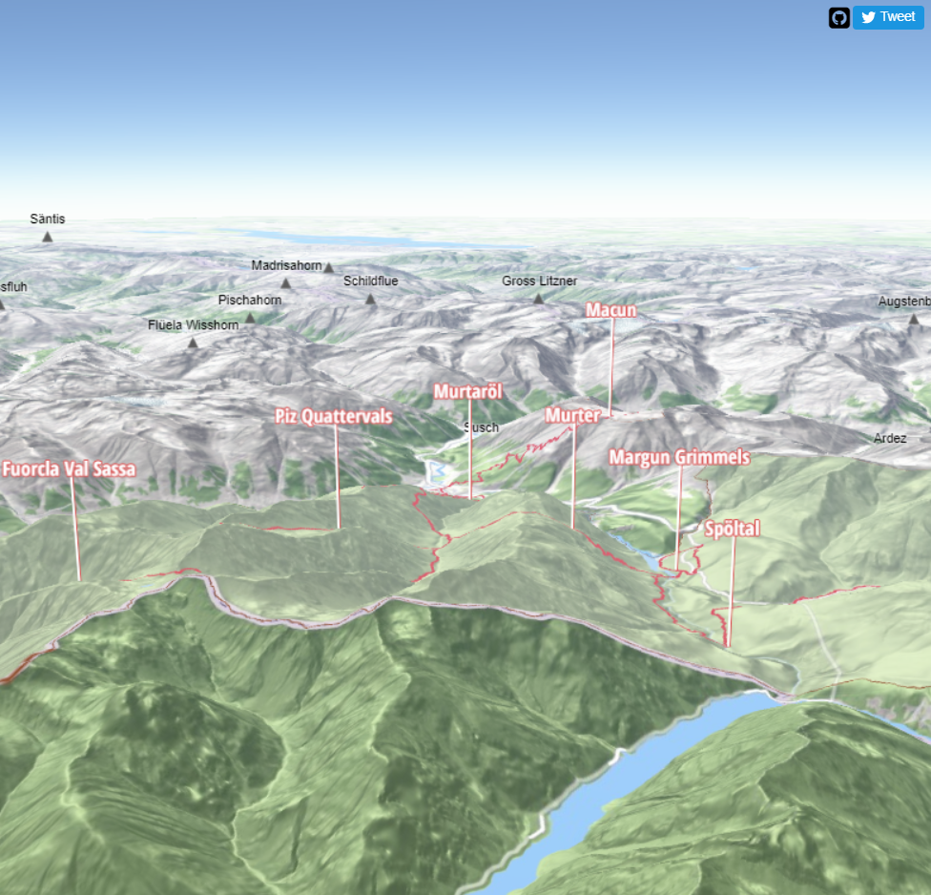
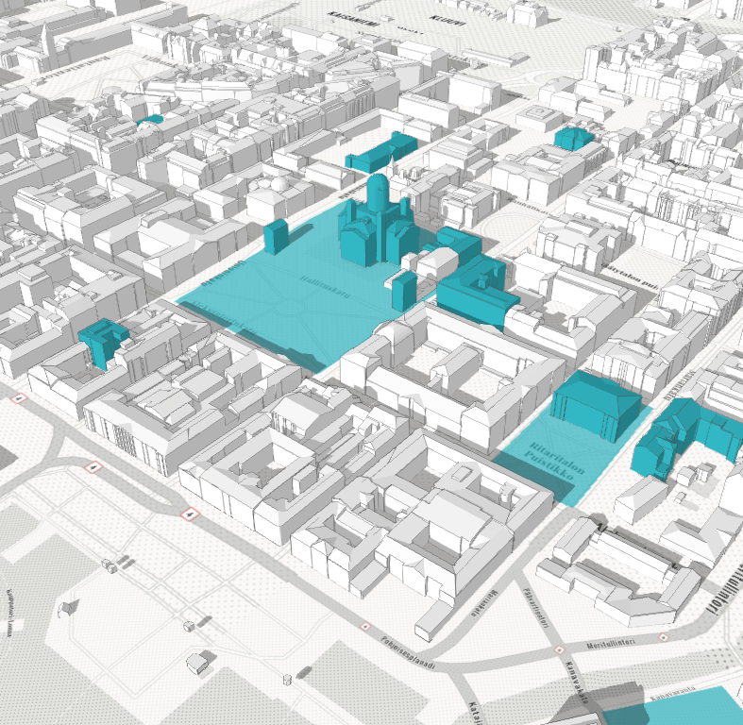
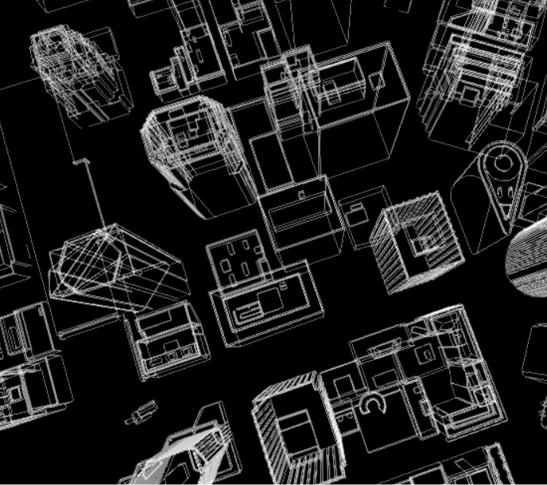
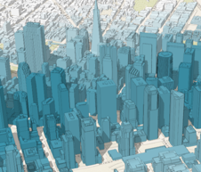
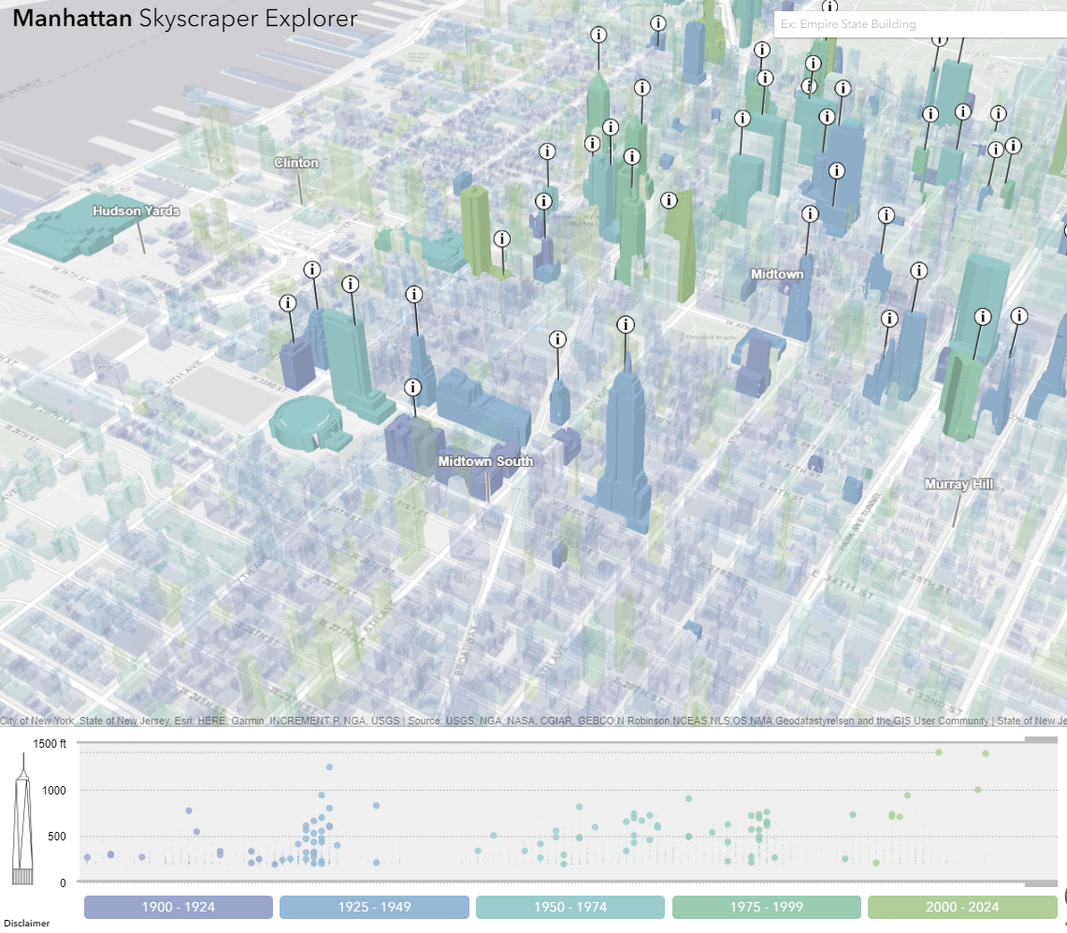
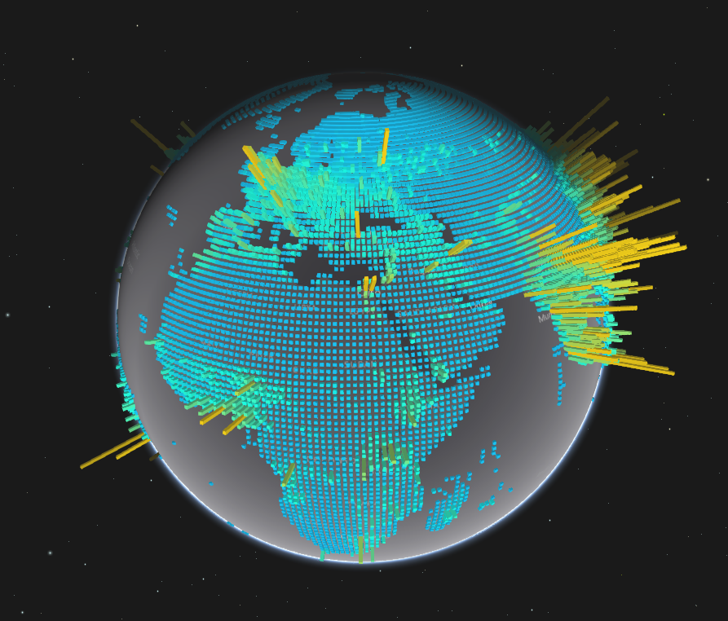
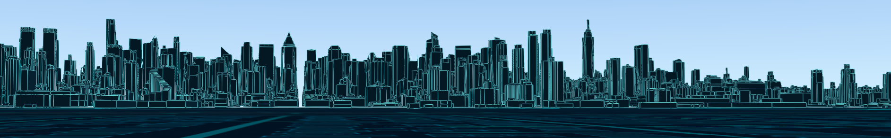

Slide 19
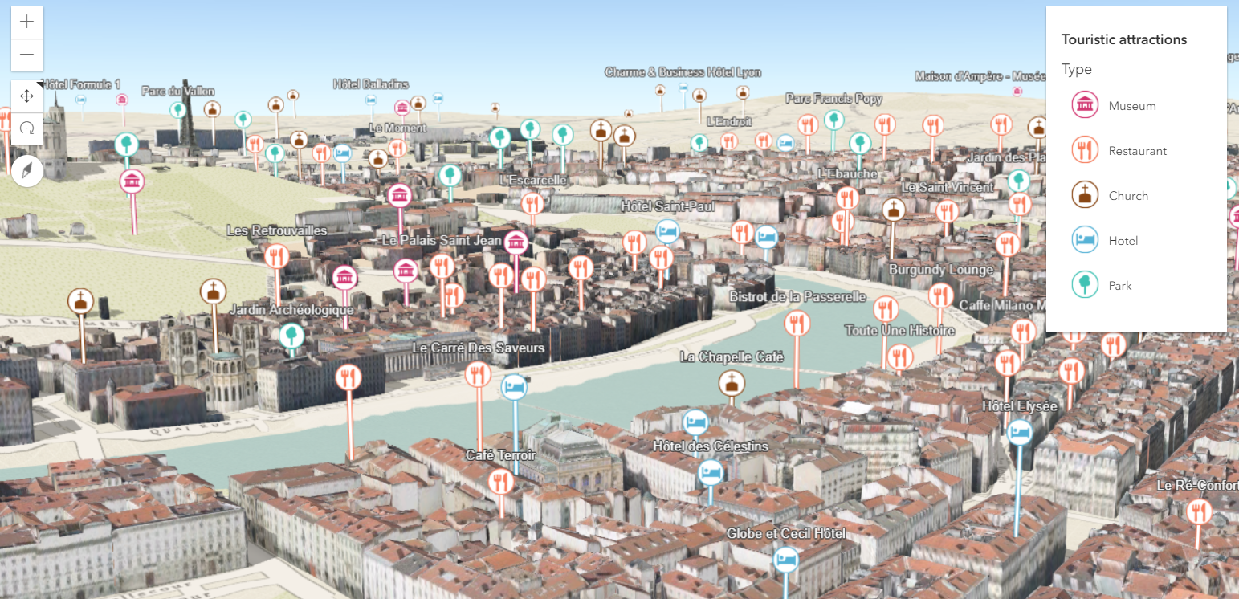
Points of interest in a city

Slide 20
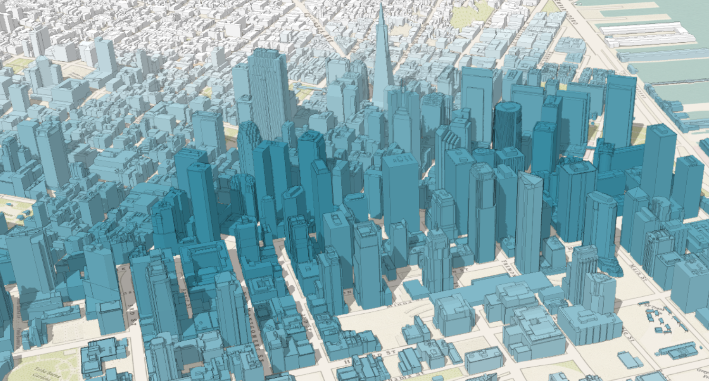
City thematic visualization

Slide 21
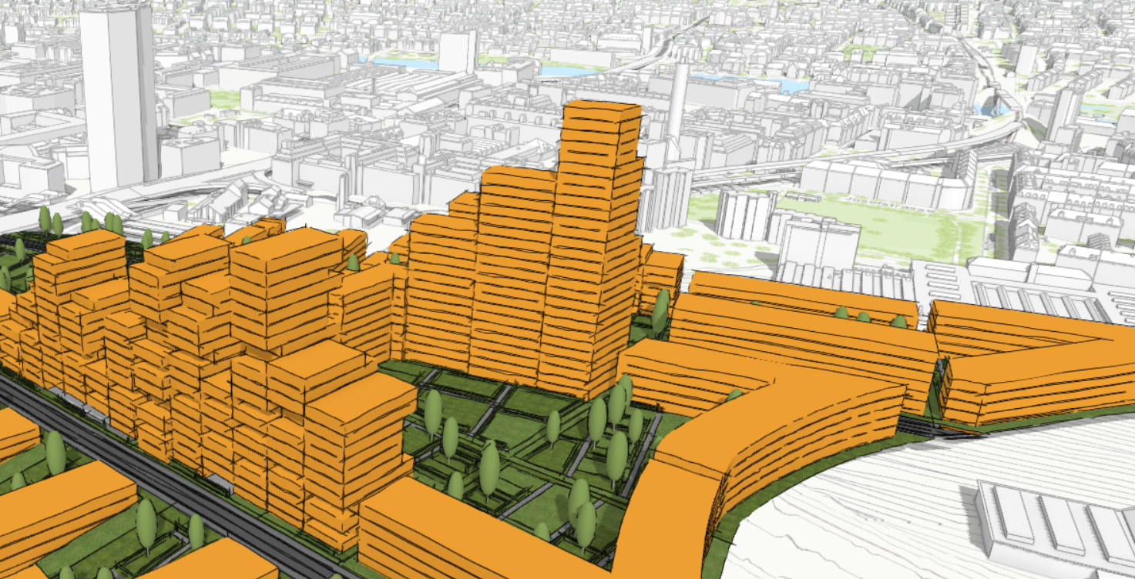
Urban development

Slide 22
Visualization API
Basic Patterns

Slide 23
layer
var layer = new FeatureLayer({
renderer: new SimpleRenderer({
symbol: new PointSymbol3D({
symbolLayers: [new IconSymbol3DLayer({…})]
})
}),
elevationInfo: {
mode: "relative-to-scene"
},
labelingInfo: [{
symbol: new LabelSymbol3D({
symbolLayers: [new TextSymbol3DLayer({…})]
})
}]
});
renderer
symbol
symbolLayers

Slide 24
var layer = new FeatureLayer({
renderer: new SimpleRenderer({
symbol: new PointSymbol3D({
symbolLayers: [new IconSymbol3DLayer({…})]
}),
visualVariables: [{
type: "size",
field: "TOTPOP_CY",
normalizationField: "SQMI",
stops: [{
value: 4000,
size: 6
},
{
value: 23000,
size: 40
}]
}]
});
renderer
symbol
symbolLayers
visualVariables
for numeric continuous visualizations

Slide 25
layer
var layer = new FeatureLayer({
renderer: new SimpleRenderer({
symbol: new PointSymbol3D({
symbolLayers: [new IconSymbol3DLayer({…})]
})
}),
elevationInfo: {
mode: "relative-to-scene"
},
labelingInfo: [{
symbol: new LabelSymbol3D({
symbolLayers: [new TextSymbol3DLayer({…})]
})
}]
});
elevationInfo
mode

Slide 26
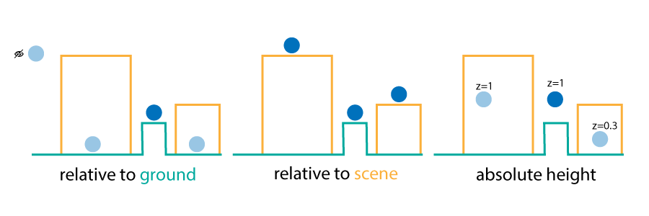
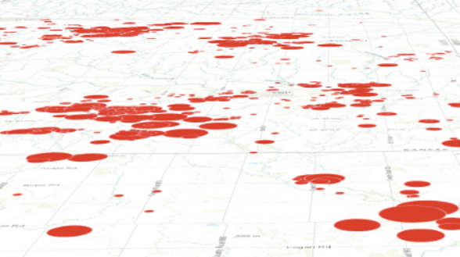
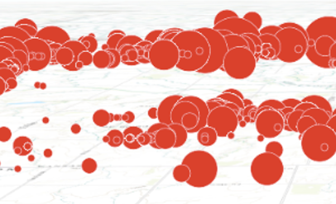
layer
elevationInfo
mode
on the ground
relative to ground

Slide 27
layer
var layer = new FeatureLayer({
renderer: new SimpleRenderer({
symbol: new PointSymbol3D({
symbolLayers: [new IconSymbol3DLayer({…})]
})
}),
elevationInfo: {
mode: "relative-to-scene"
},
labelingInfo: [{
symbol: new LabelSymbol3D({
symbolLayers: [new TextSymbol3DLayer({…})]
})
}]
});
labelingInfo
symbol
symbolLayers

Slide 28
Demos

Slide 29
3D Specific Symbols and Renderers

Slide 30
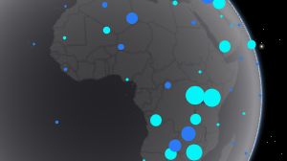
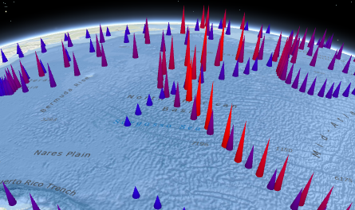
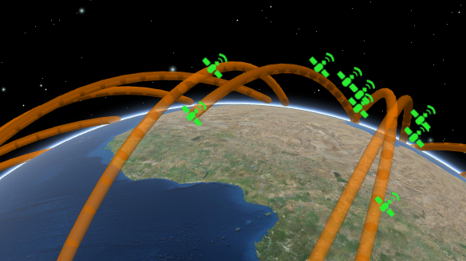
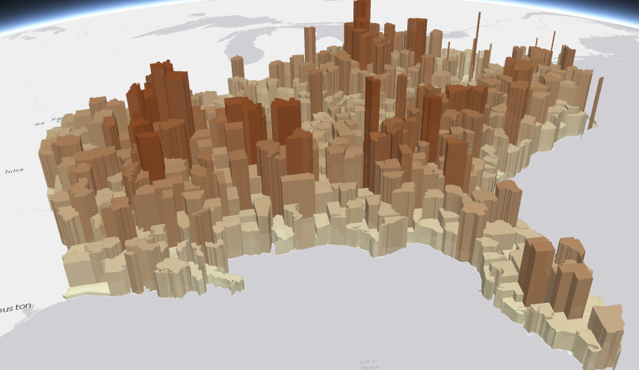
Symbols
PointSymbol3D
LineSymbol3D
PolygonSymbol3D
IconSymbol3DLayer
LineSymbol3DLayer
FillSymbol3DLayer
Flat
- Screen size units (pt, px)
- Graphics are in screen space
PathSymbol3DLayer
ExtrudeSymbol3DLayer
Volumetric
- Real world units (feet, meter)
- Graphics are in real world space
ObjectSymbol3DLayer

Slide 31
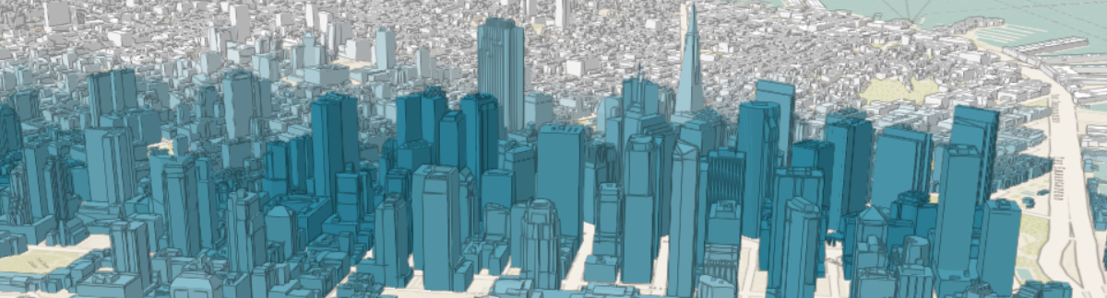
Symbols
MeshSymbol3D
FillSymbol3DLayer

Slide 32
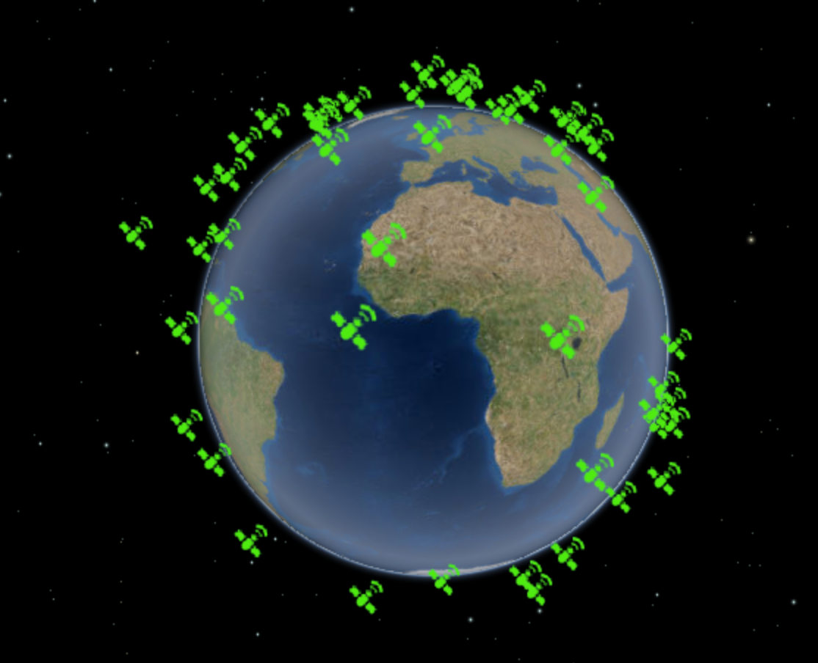
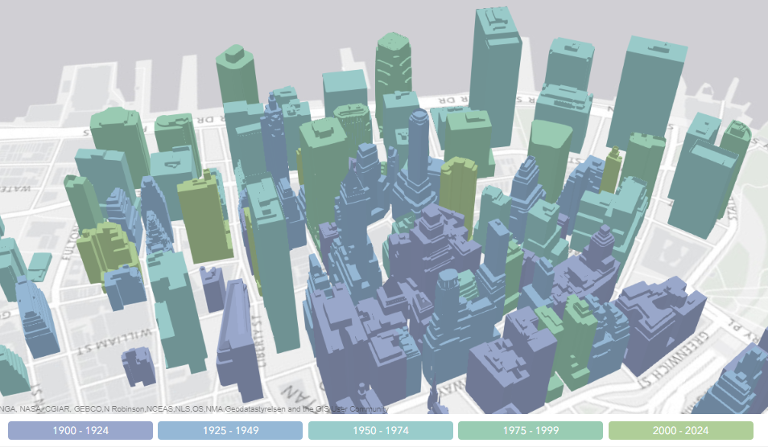
Renderers
SimpleRenderer
UniqueValueRenderer
ClassBreaksRenderer

Slide 33
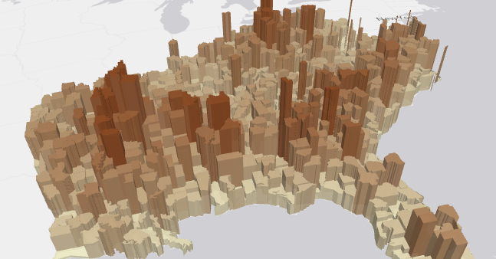
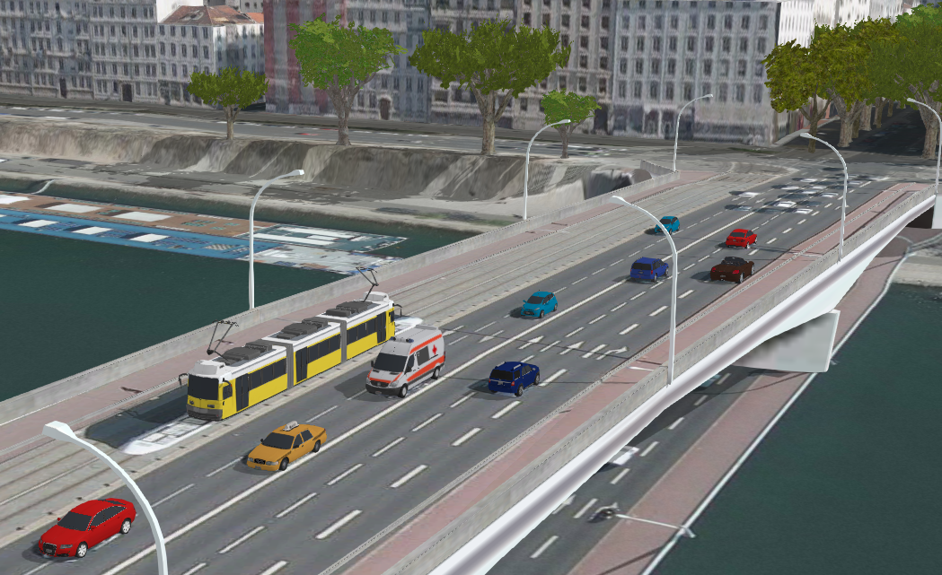

Multivariate mapping with visual variables
visualVariables - only for continuous numerical visualization
Color
Size
Rotation
Opacity

Slide 34
Sneak peak

Slide 35



Edge rendering – already in 4.7

Slide 36


Lighting conditions

Slide 37



Line styles

Slide 38
Questions

Slide 39






Please Take Our Survey in the Esri Events App
Download the Esri Events app and find your event
Select the session you attended
Scroll down to find the feedback section
Complete answers
and select “Submit”

Slide 40



